Slide 1
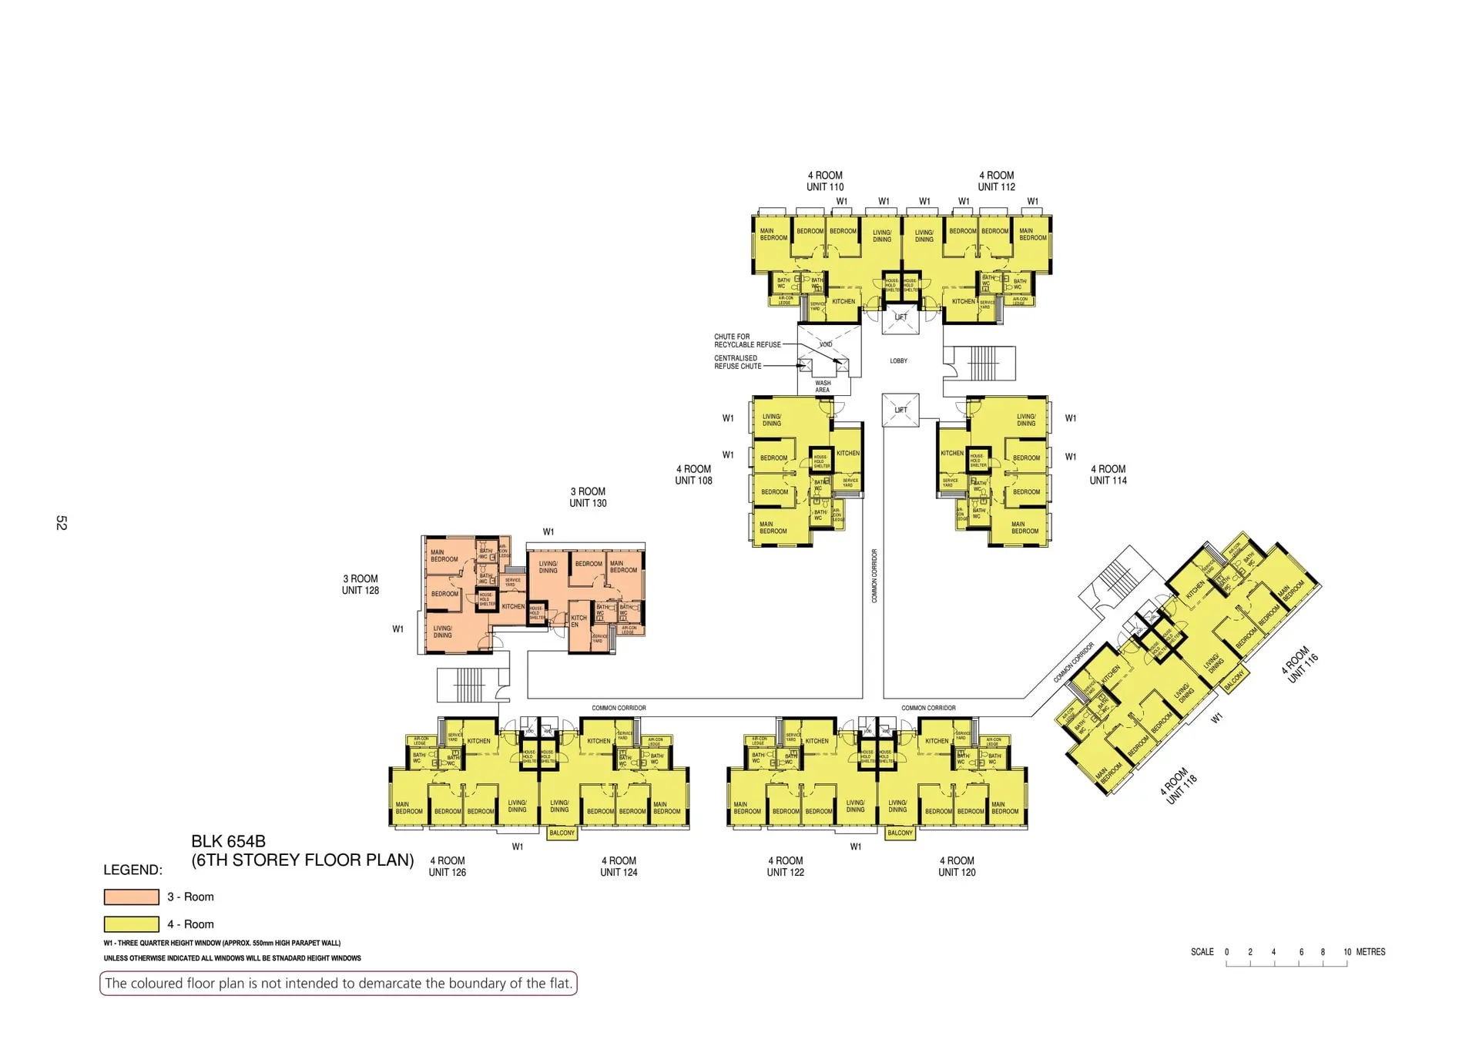

Slide 2
Blk 654B
1st Storey
Unit 108
Unit 114
Unit 126
Unit 124

Slide 3
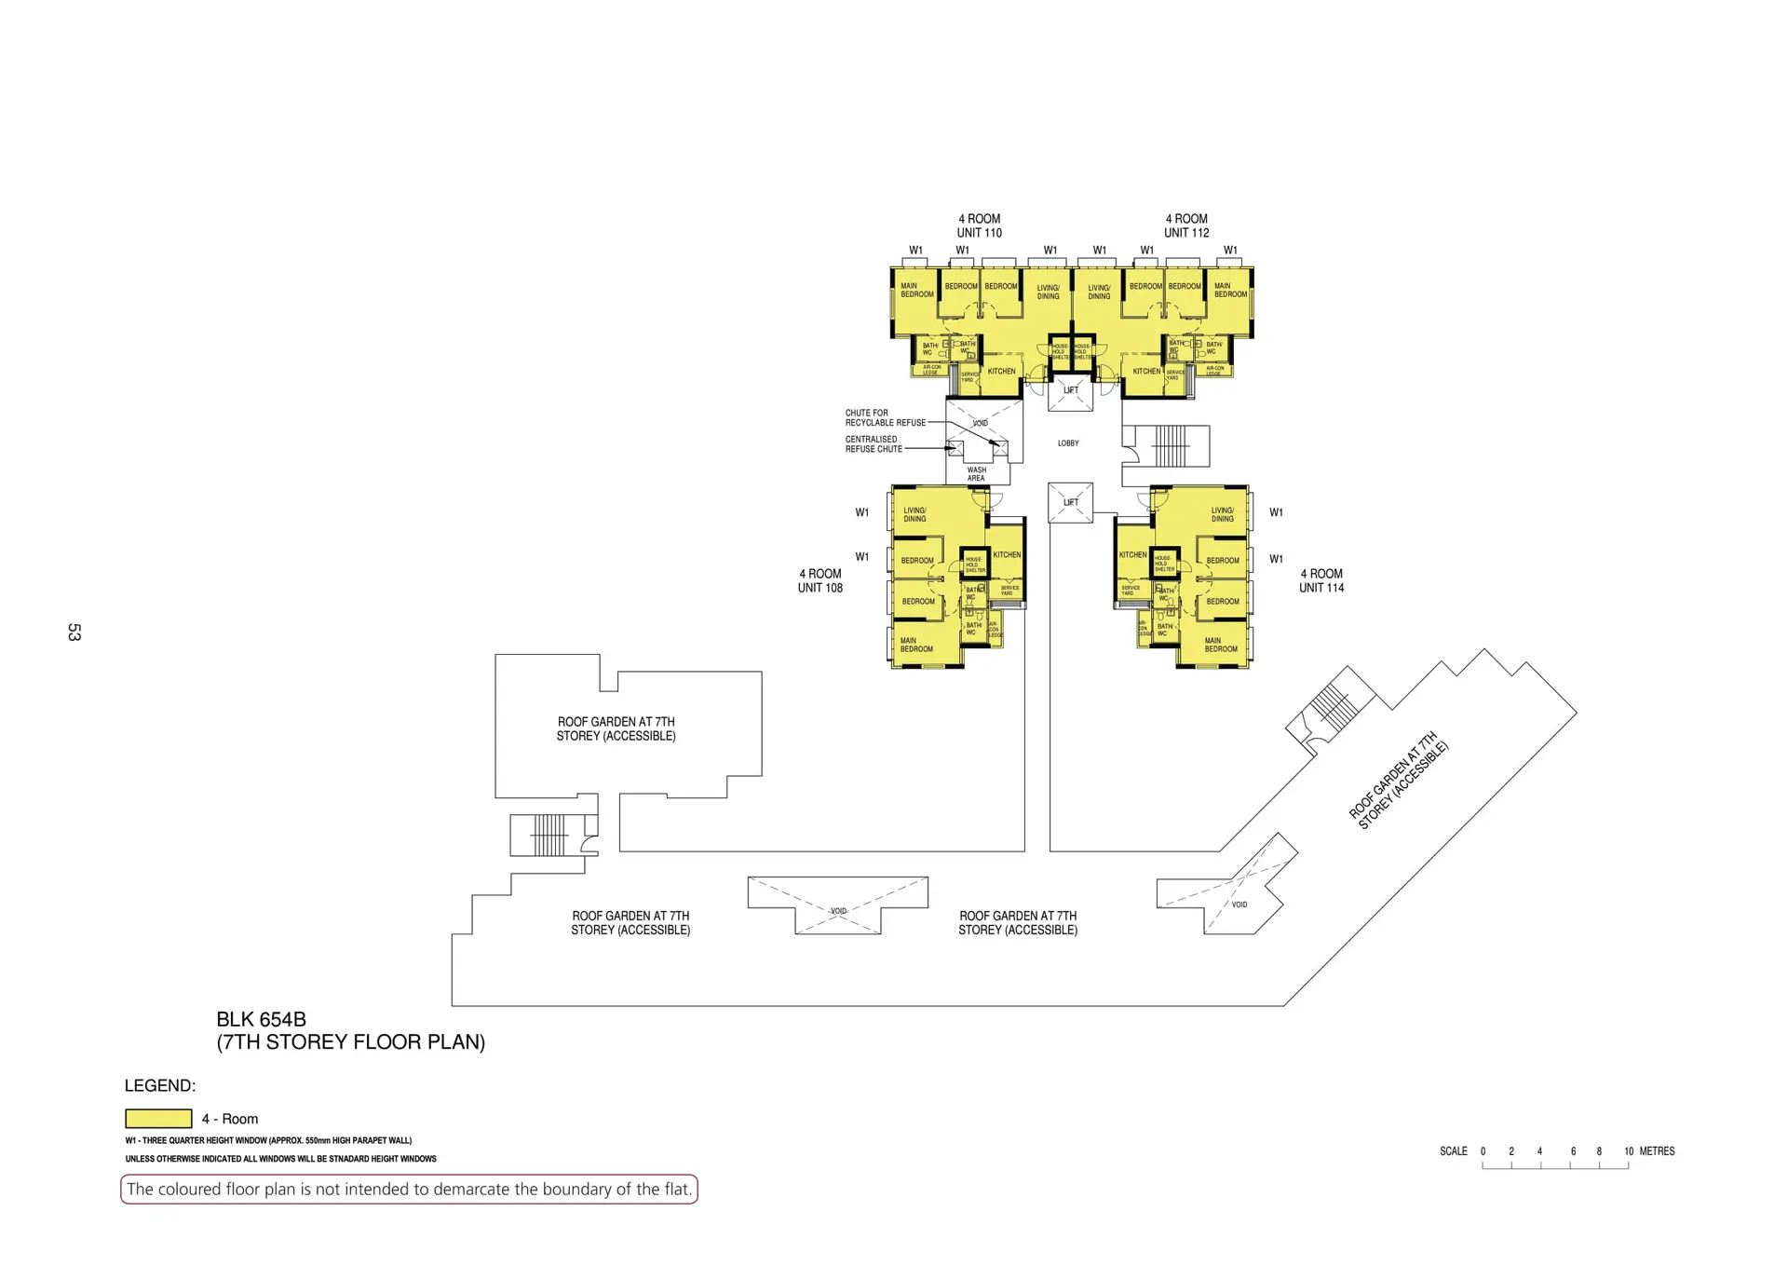
Blk 654B
Lvl 7
Unit 110
Unit 112
Unit 108
Unit 114

Slide 4
Blk 654B
2nd to 6th Storey
Unit 110
Unit 112
Unit 108
Unit 114
Unit 128
Unit 130
Unit 116
Unit 118
Unit 126
Unit 124
Unit 122
Unit 120

Slide 5
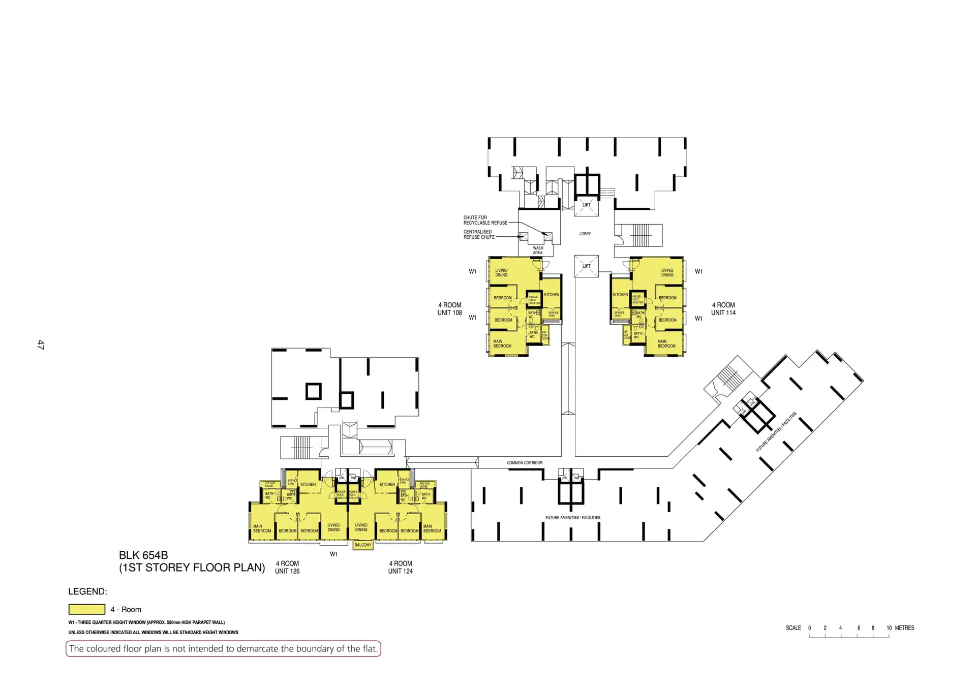
Blk 654B
Lvl 1
Unit 108
Unit 114
Unit 126
Unit 124

Slide 6
Blk 654B
7th Storey (Roof Garden)
Unit 110
Unit 112
Unit 108
Unit 114
Roof Garden
Roof Garden
Roof Garden
Roof Garden

Slide 7
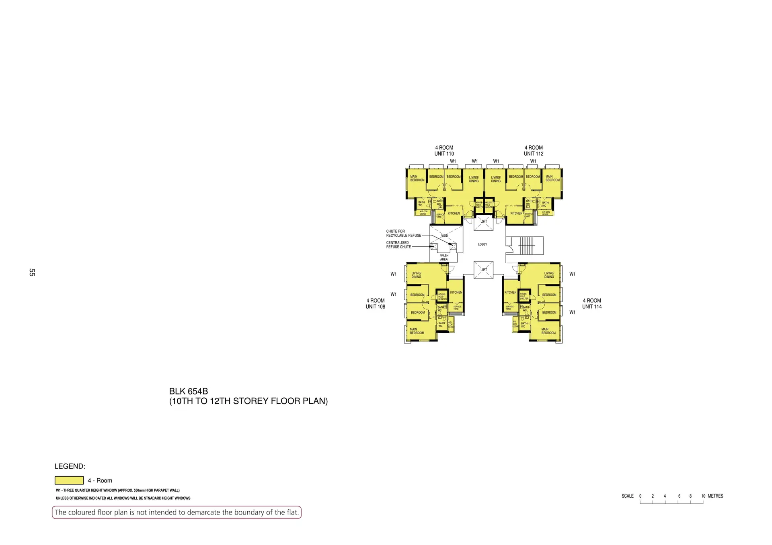
Unit 110
Unit 112
Unit 108
Unit 114

Slide 8
Blk 654B
8th – 14th Storey
Unit 110
Unit 112
Unit 108
Unit 114

